Slide 1
Satellite Remote Sensing of the Ocean
Dr. Tiago Silva - Physical Oceanographer AgriFoRwArdS Summer School 5-7-2022
tiago.silva@cefas.co.uk

Slide 2
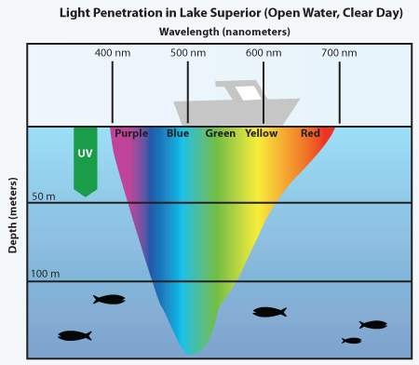
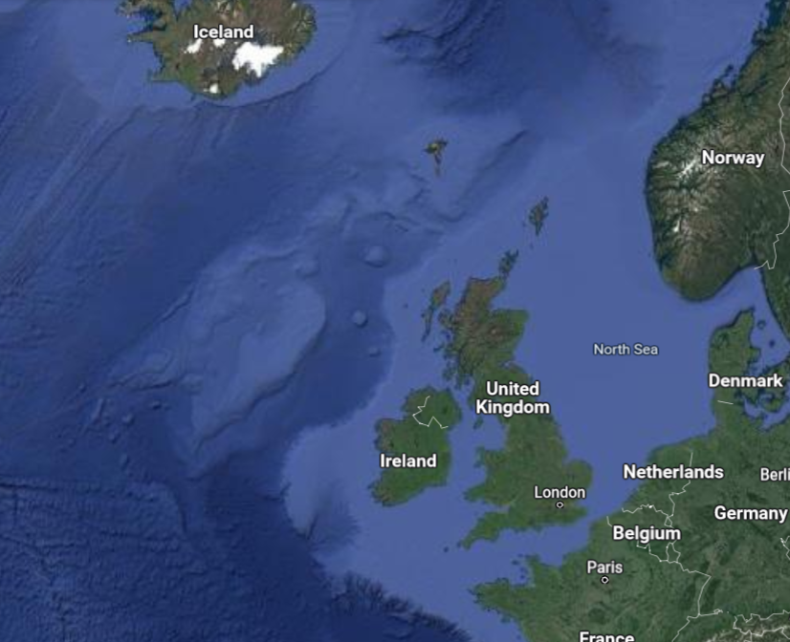
The Ocean: why it is mostly hidden?
Visible spectrum: can tell us about what is in the water:
Sediment, Chlorophyll A,
dissolved organic matter
Abyssal plains 4000 m
Continental Shelf 200 m

Slide 3
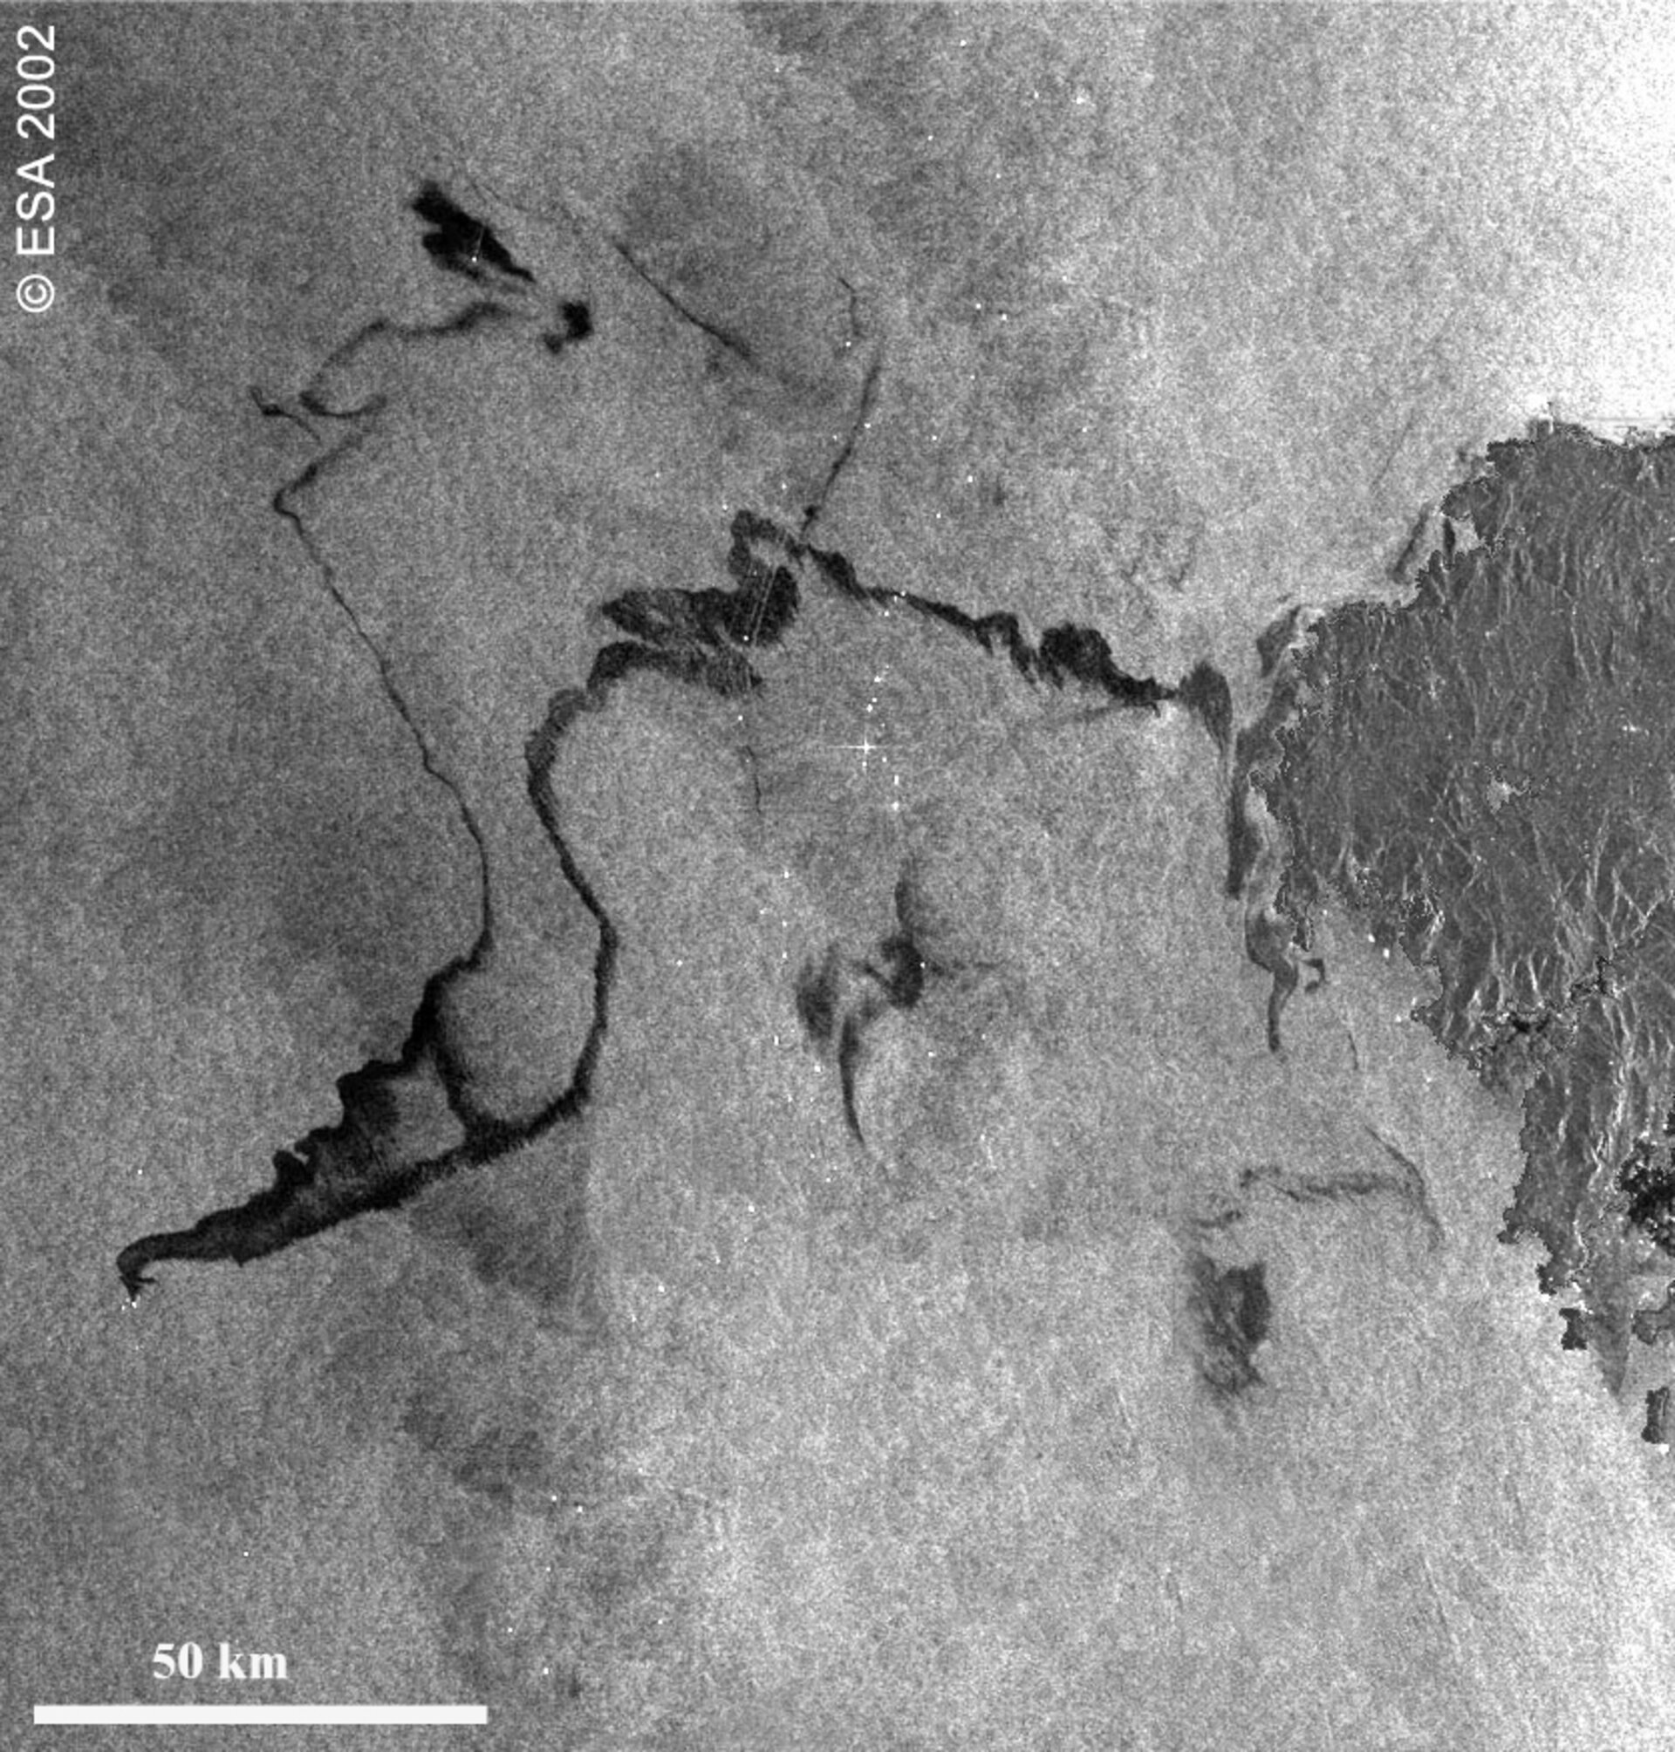
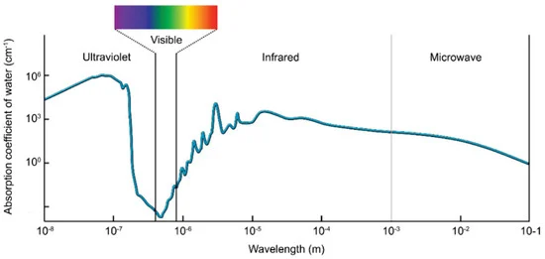
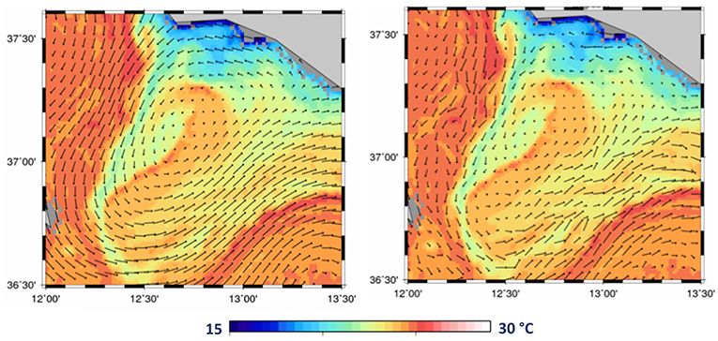
The Ocean: why it is mostly hidden?
Microwave spectrum: absorbed in millimetres!
Surface shape: tides, wave height, oil spills, ships, floating litter
Top mms: salinity, temperature, surface currents
Surface currents and temperature

Slide 4
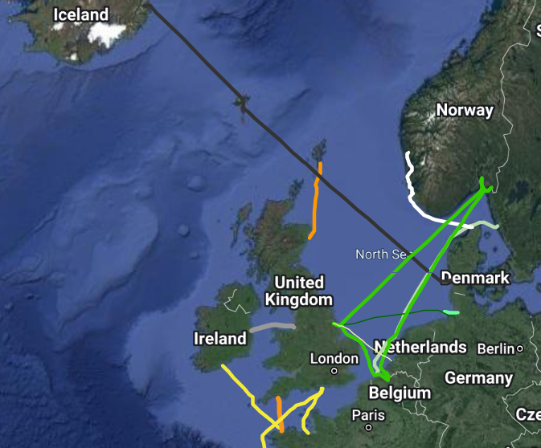
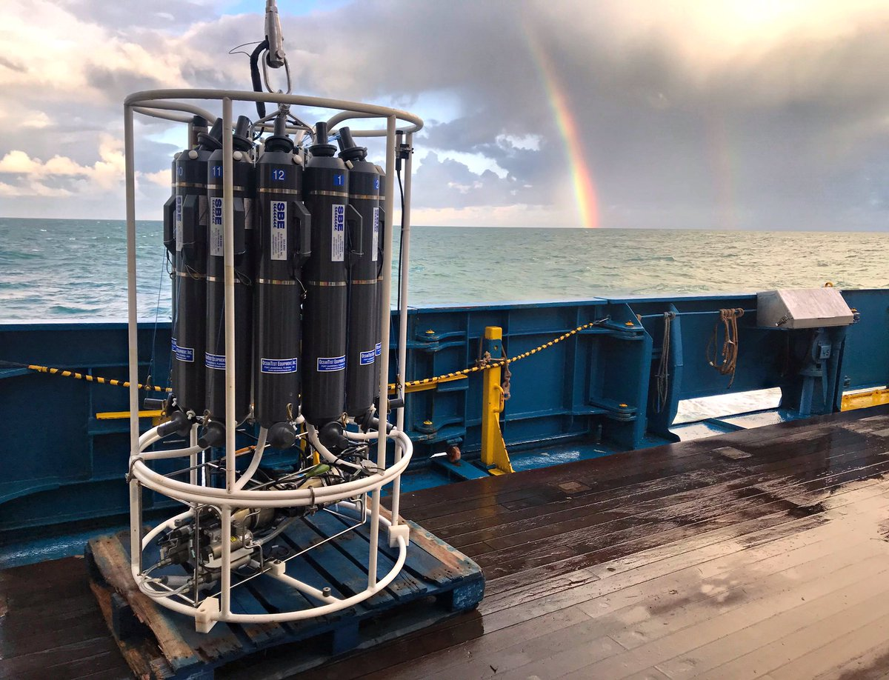
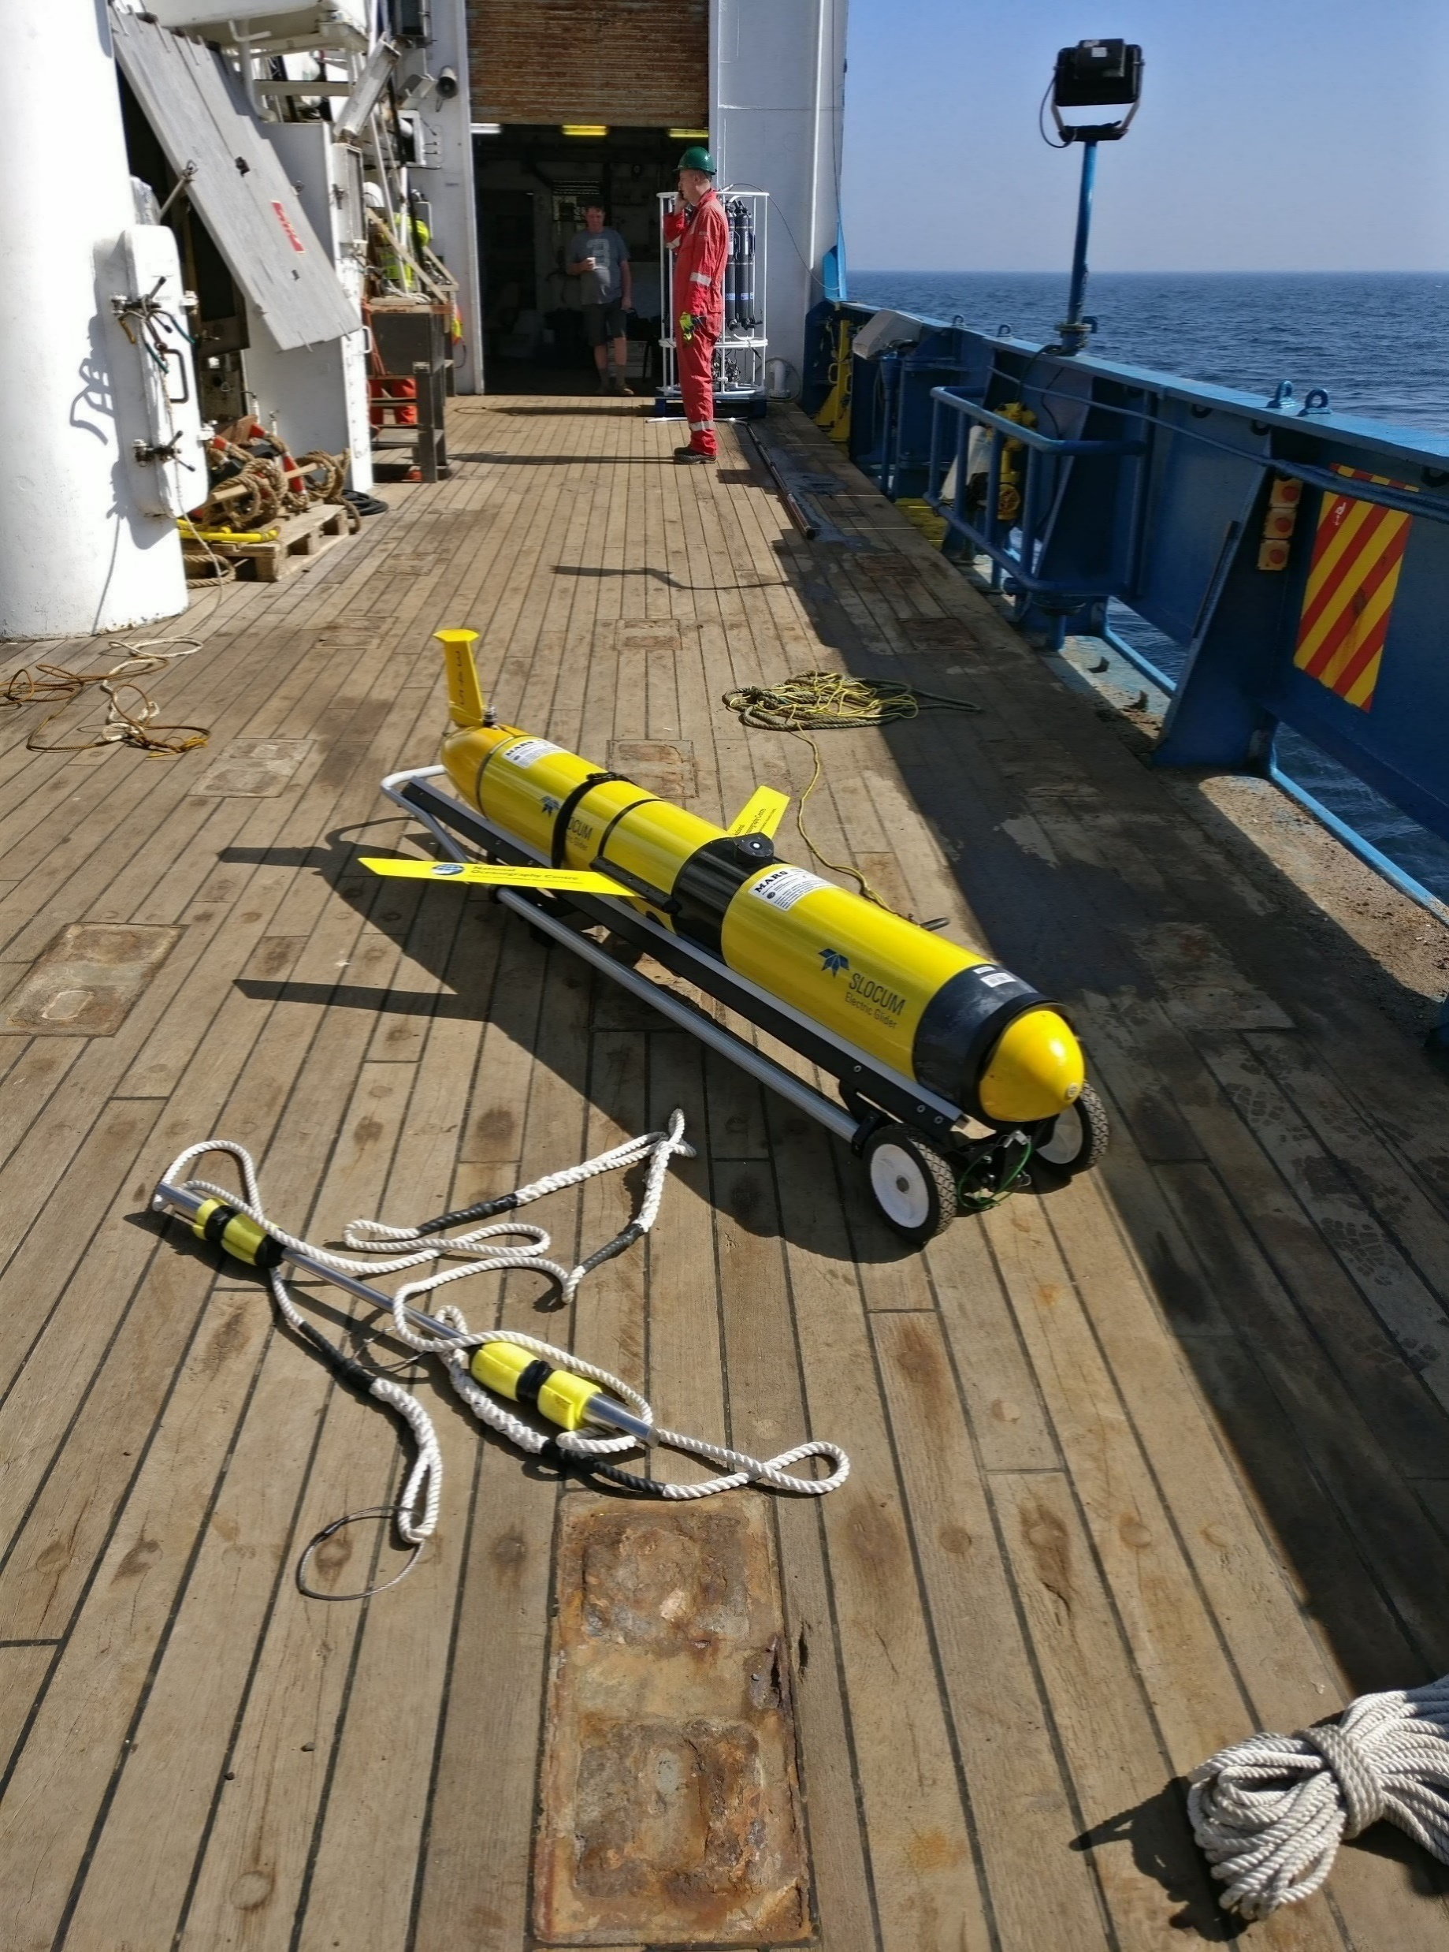
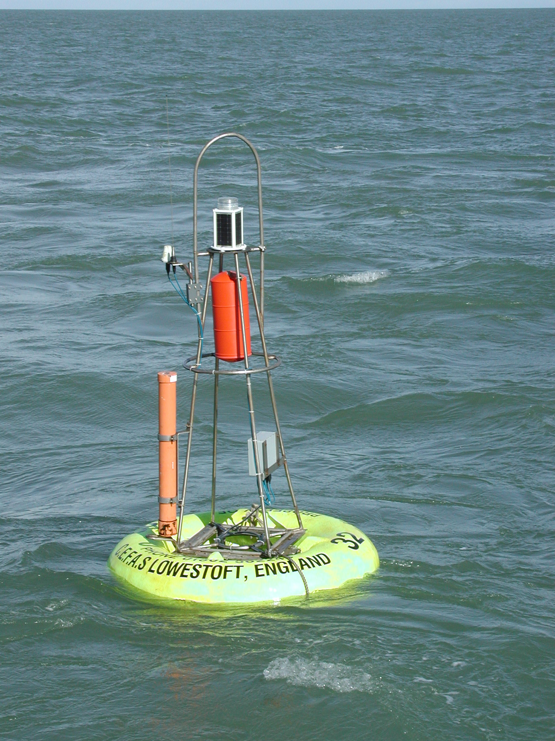
In situ vs. remote sensing: a question of scales
Sampling of water volume < 1 litre, analysis in the lab: e.g. Chlorophyll A
Sensor in the water: e.g. temperature or Chlorophyll A (remote sensing)
Sensors can record continuously, but small volume at a time
SmartBuoy
CTD
Rosette
Glider
https://www.ferrybox.org/routes_data/routes/north_sea_atlantic/

Slide 5
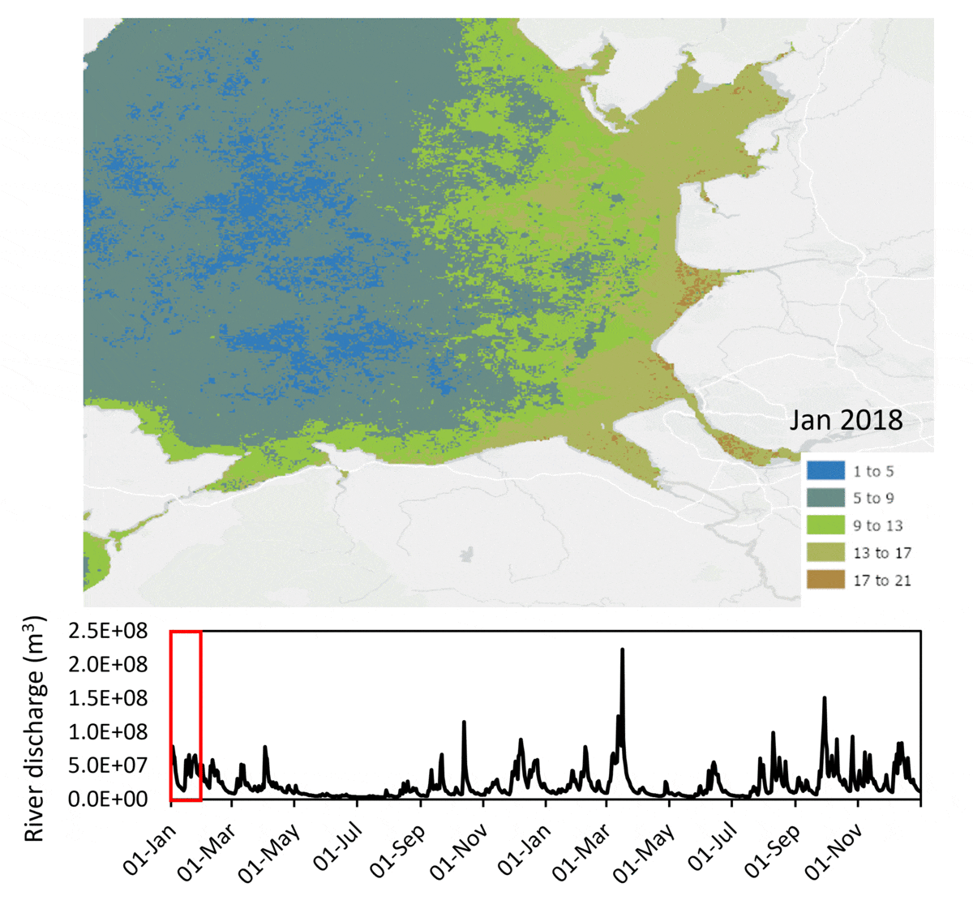


In situ vs. remote sensing: a question of scales
Forel Ule water type in Liverpool Bay from Sentinel 3
Satellite give global coverage every 1 to 15 days
Typical resolutions of 10 m to 1 km
Visible is affected by cloud cover and restricted to daytime (sampling bias): 2/3 images unusable
300 m
10 m
10⁹ or a trillion times the volume of a water sample!
In situ accuracy vs. sampling over larger variability
Fronkova et al 2022

Slide 6
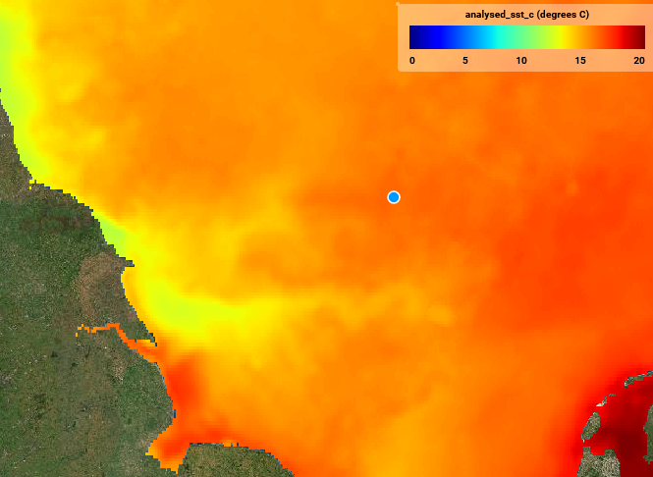
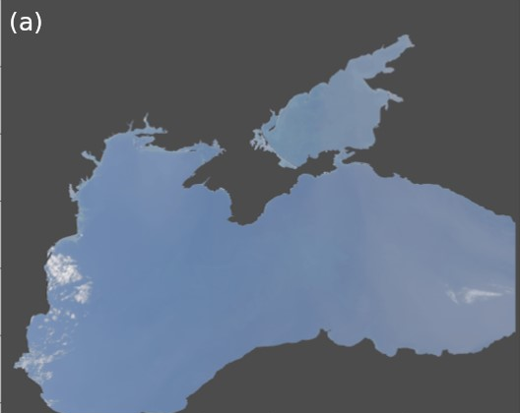
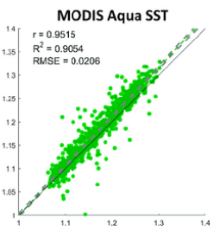
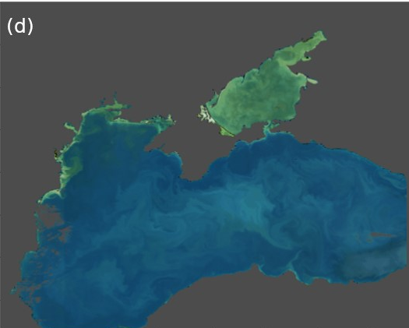
Ocean RS: values over features
Forel Ule water type in Liverpool Bay from Sentinel 3
For Chlorophyll A, sediment load aim for <30% error
Atmospheric correction is essential for this as only 10% of energy observed comes from ocean
Sea Surface Temperature (Odyssea 2km)
on 2022-07-03
https://eutro-cube.cefas.co.uk/
https://www.eumetsat.int/SACSO

Slide 7
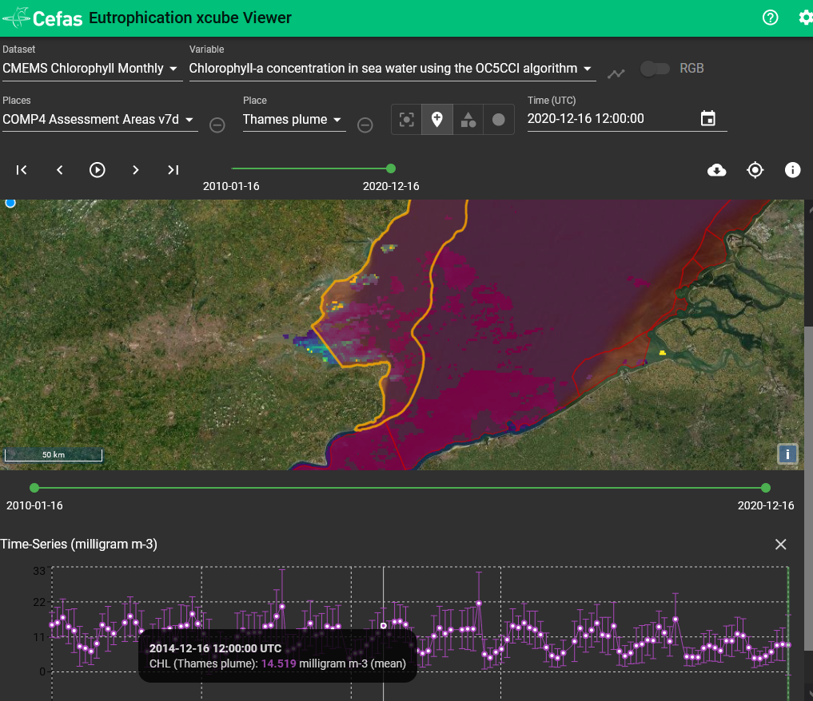
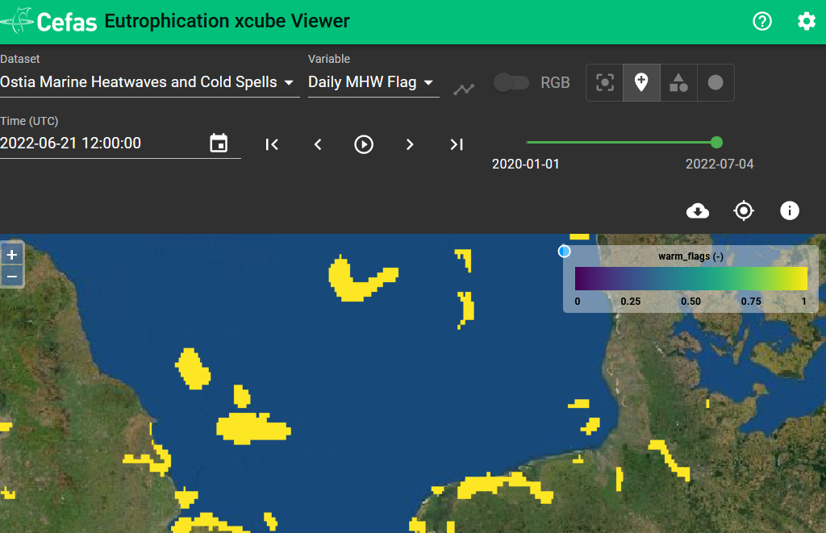
Applications of Satellite Oceanography at Cefas
Monitoring water quality:
river pollution, algal blooms, heatwaves
https://eutro-cube.cefas.co.uk/

Slide 8
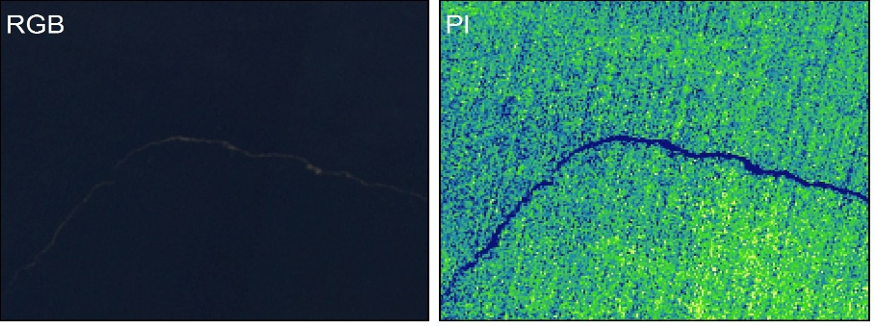
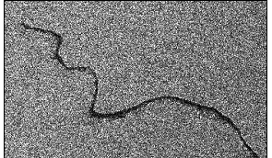
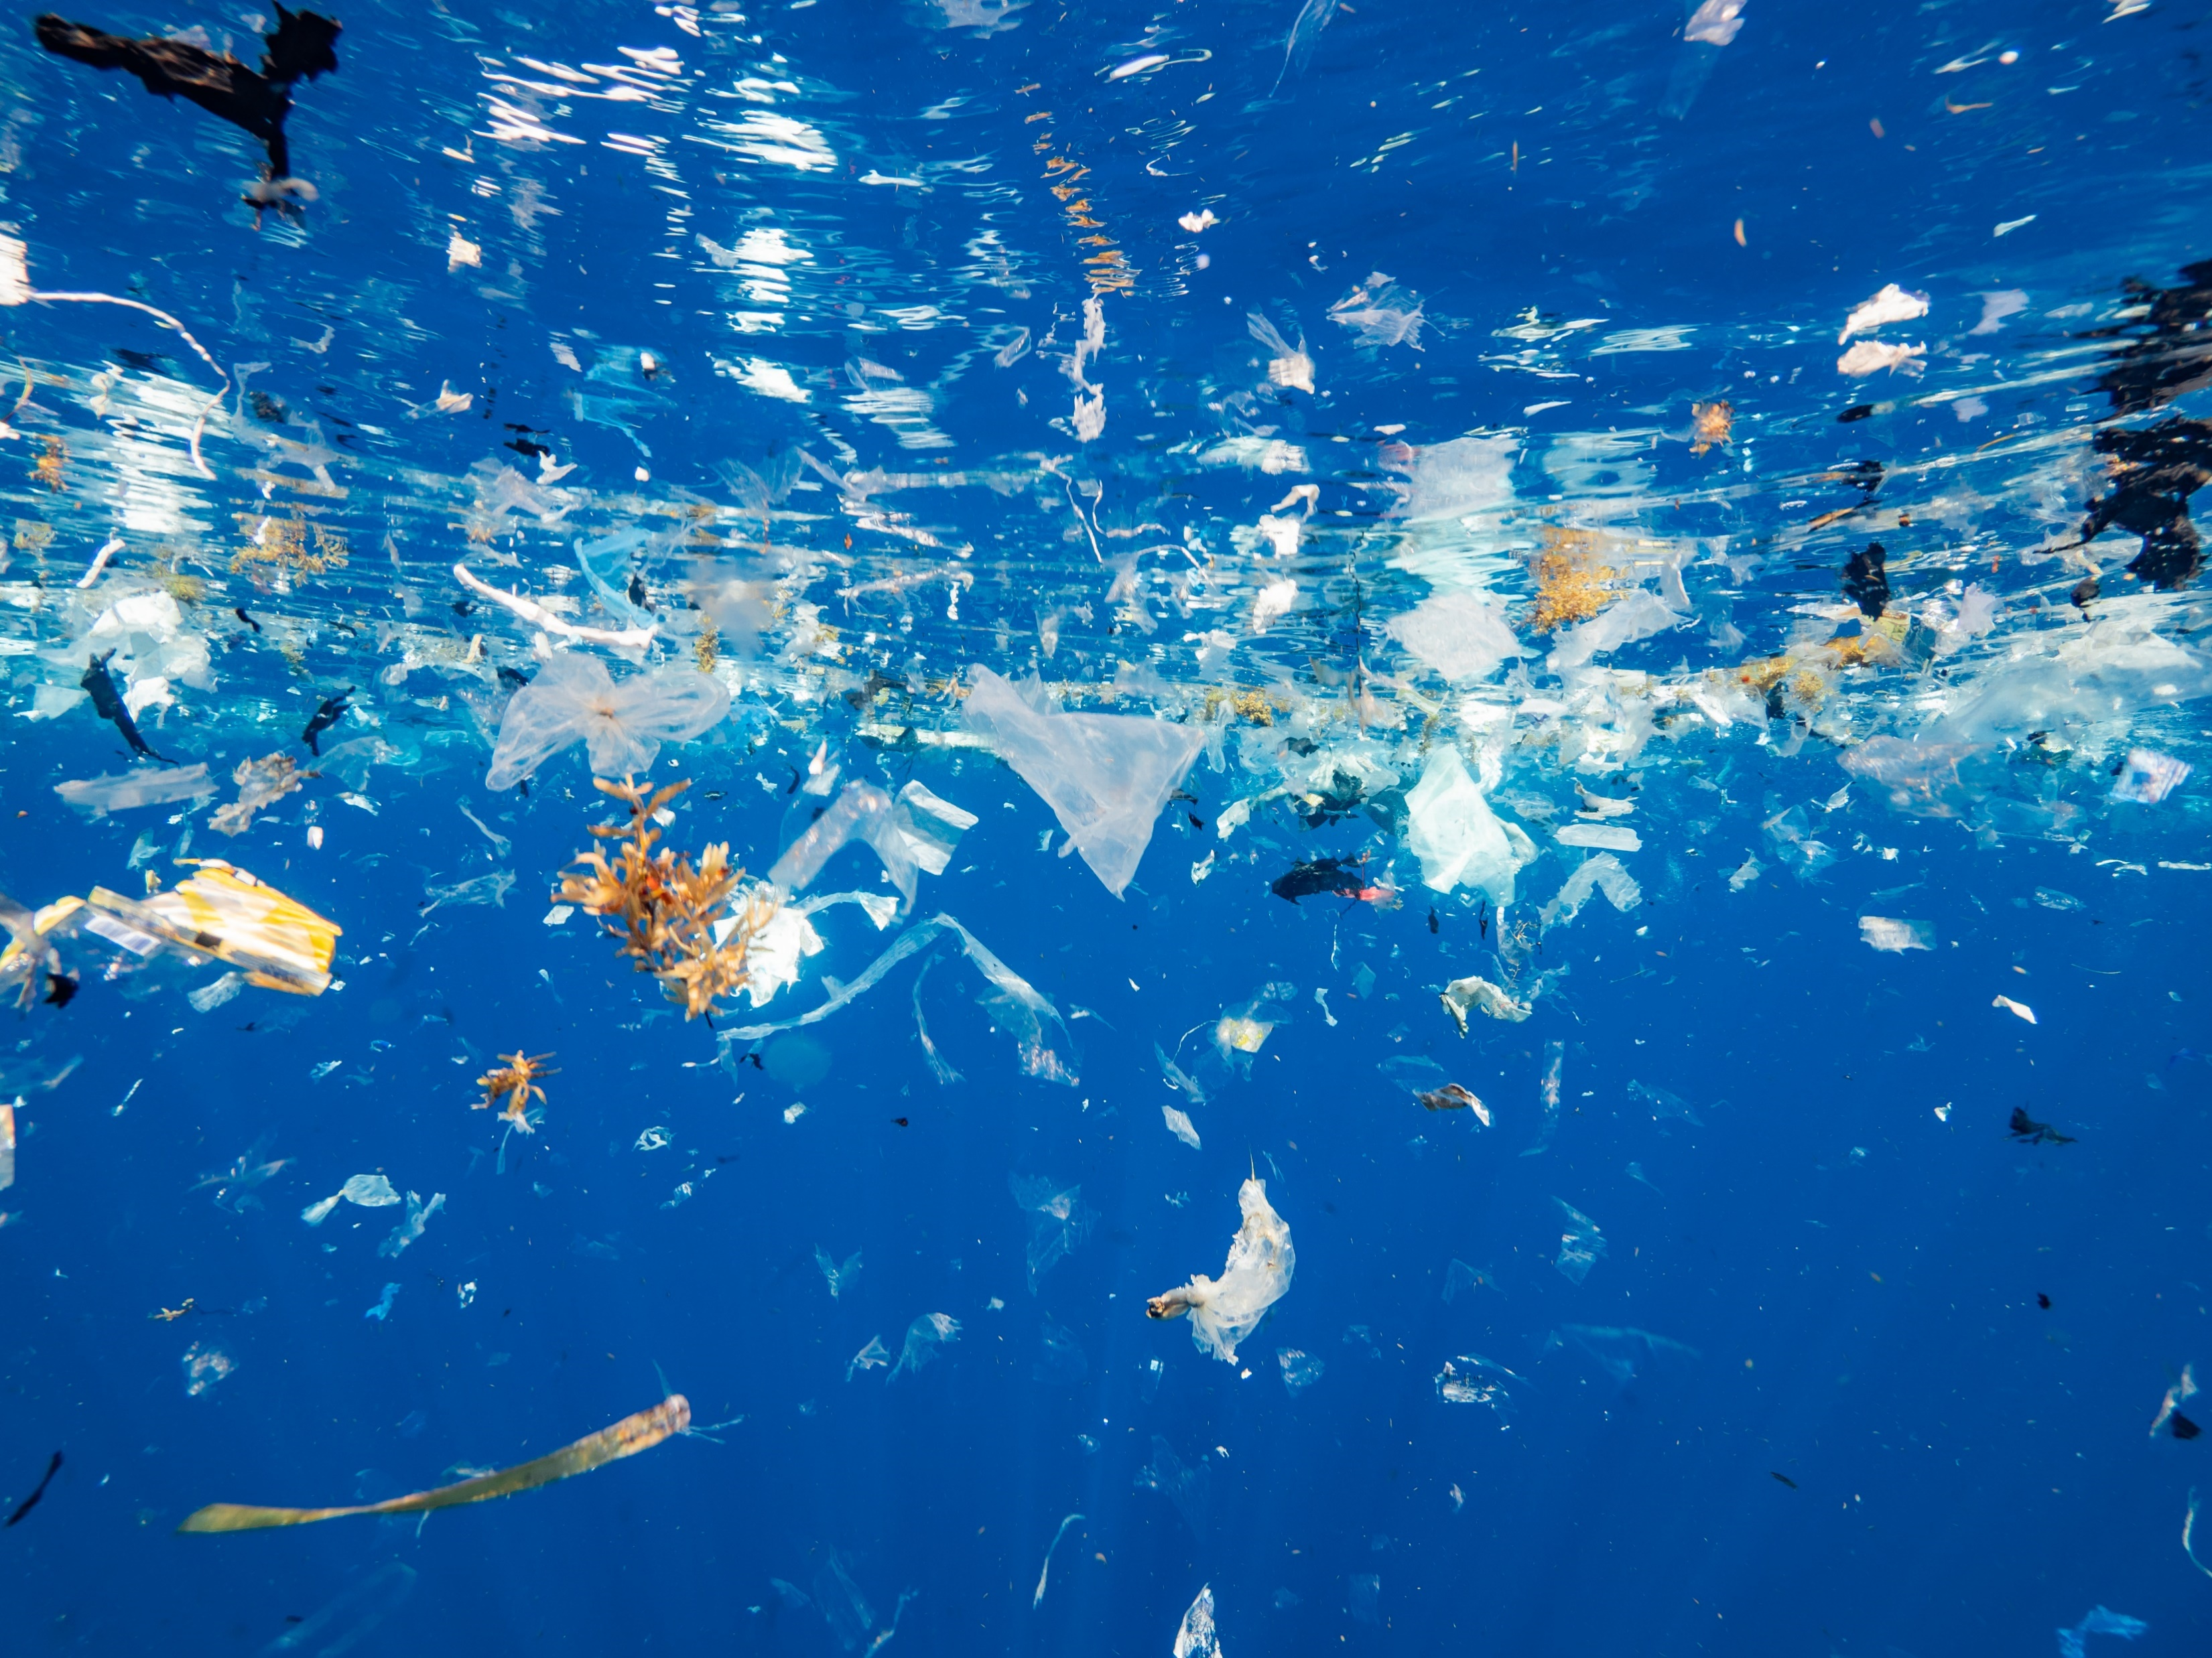
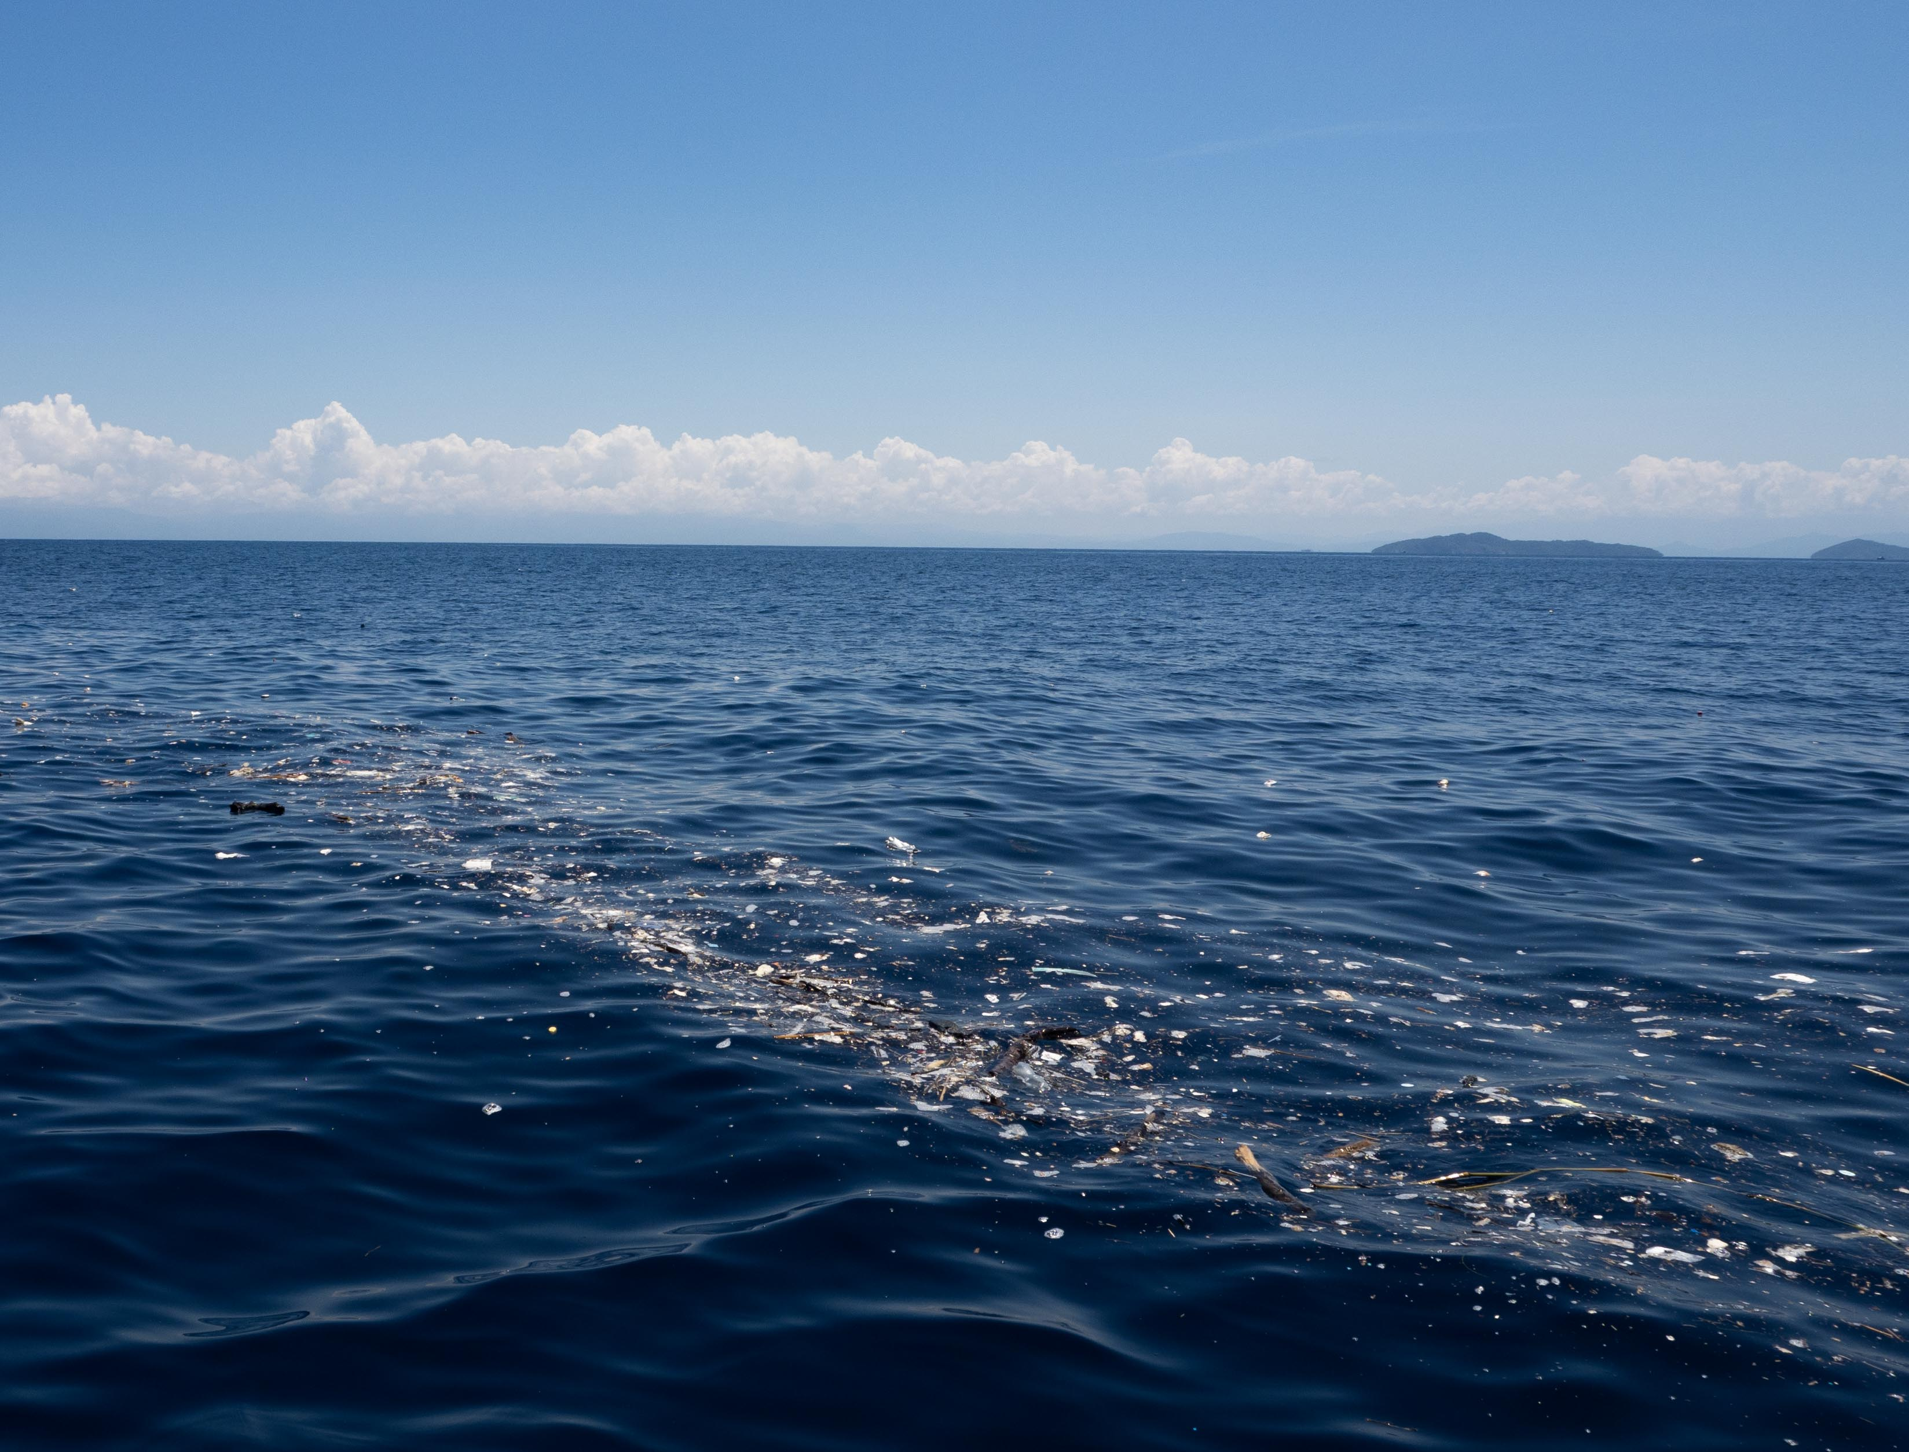
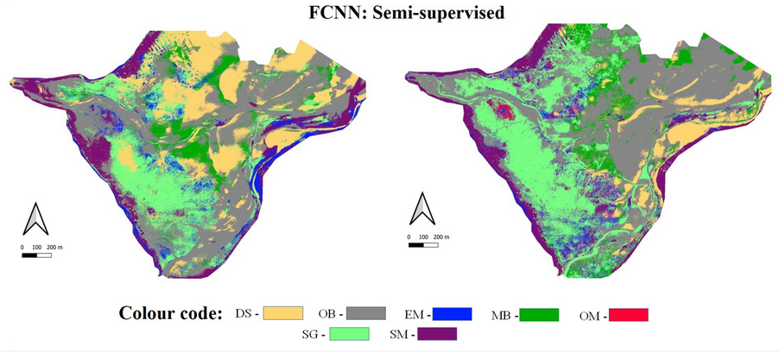
Applications of Satellite Oceanography at Cefas
Detection of floating litter: Honduras
Emergency response to maritime accidents
Mapping of coastal habitats
Hobley et al. 2021
RPA survey of Budle Bay

Slide 9
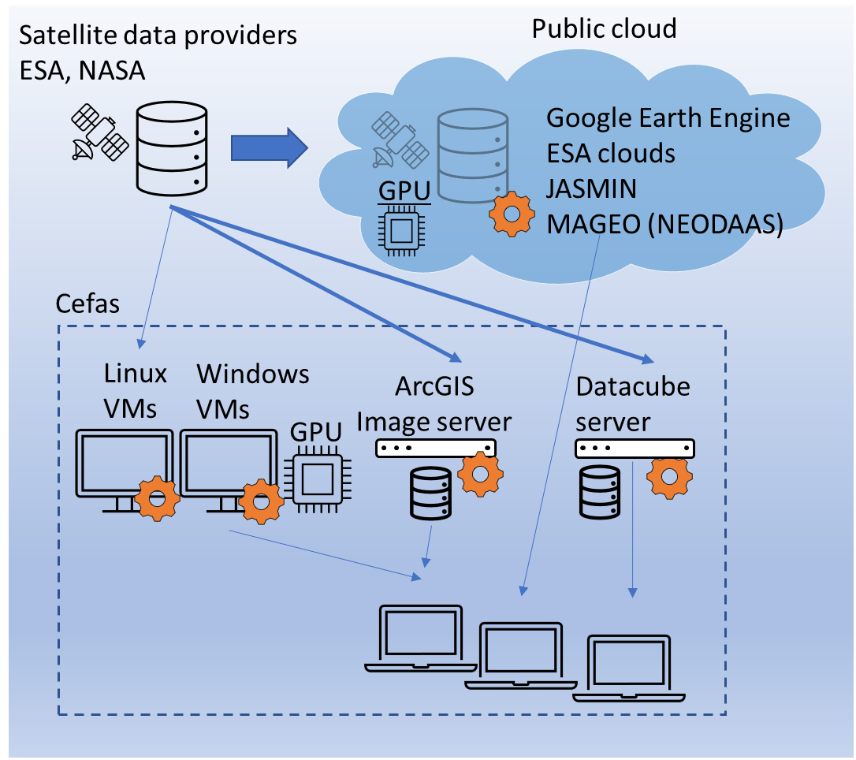
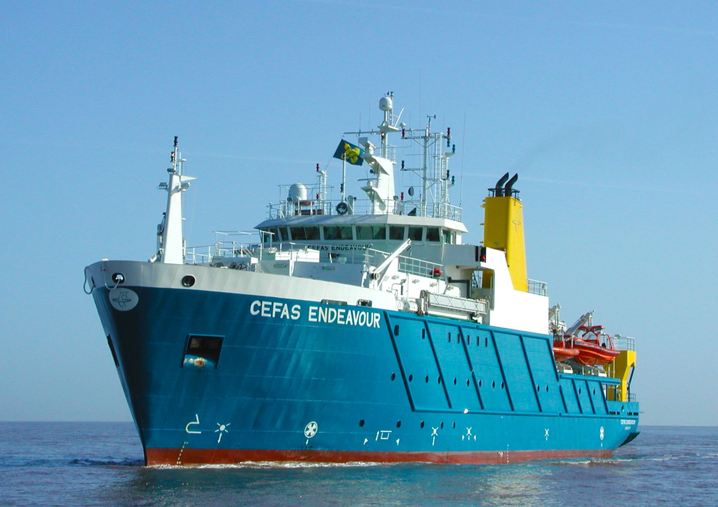
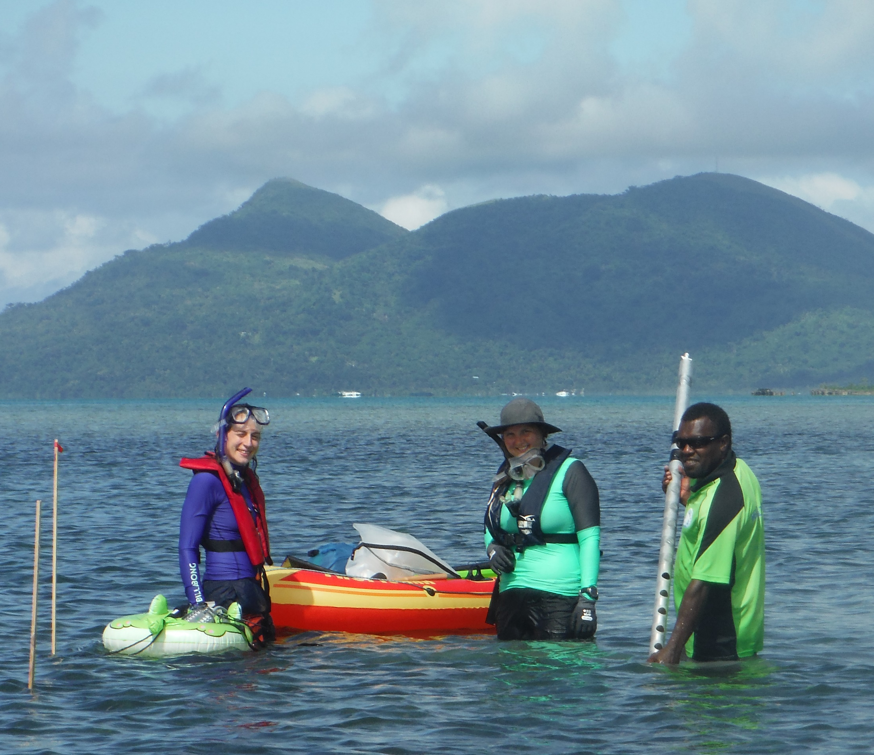
How do we do this:
Data processing
Data->Information
In situ sampling supports development
of algorithms and validation

Slide 10
@
tom.karsten@cefas.co.uk

